Slide 1
Great Boston Molasses Flood 1919

Slide 2
Tank layout and neighbourhood

Slide 4
https://www.youtube.com/watch?v=Bl8Unowv5XA

Slide 5
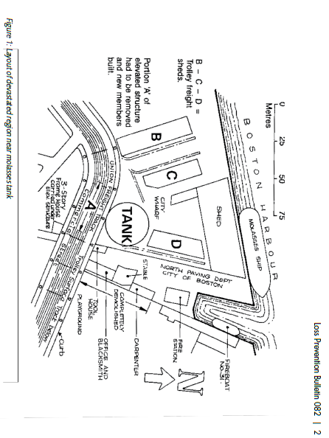

Slide 6
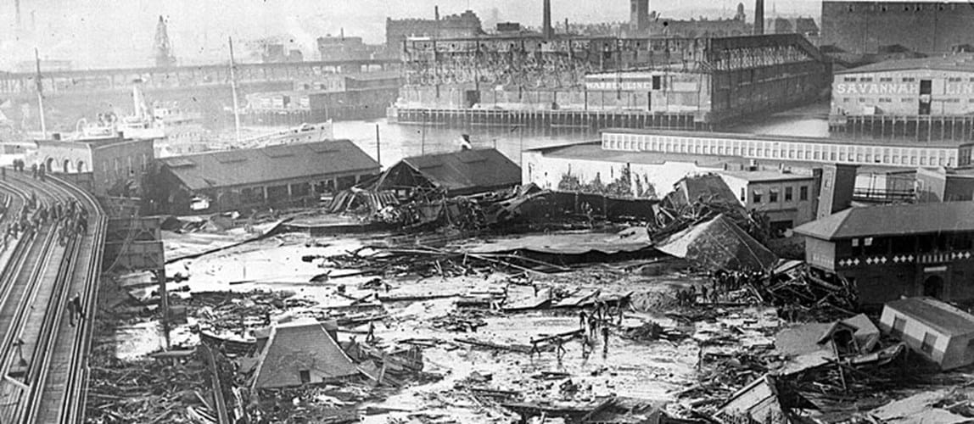

Slide 7
The devastating aftermath of the Molasses tank rupture. The remains of the tank can be seen top right, below the white building.

Slide 8
Close-up of the molasses tank roof

Slide 9
Who died?
William Duffy | 58 | Laborer (North End Paving Yard)
William Brogan | 61 | Teamster
Thomas Noonan | 43 | Longshoreman
Stephen Clougherty | 34 | Unemployed
Ralph Martin | 21 | Driver
Peter Shaughnessy | 18 | Teamster
Peter Francis | 64 | Blacksmith (North End Paving Yard)
Patrick Breen | 44 | Laborer (North End Paving Yard)
Pasquale Iantosca | 10 | Child
Michael Sinnott | 78 | Messenger
Maria Di Stasio | 10 | Child
John M. Seiberlich | 69 | Blacksmith (North End Paving Yard)
John Callahan | 43 | Paver (North End Paving Yard)
James McMullen | 46 | Foreman, Bay State Express
James Lennon | 64 | Teamster/Motorman
James H. Kenneally | Unknown | Laborer (North End Paving Yard)
George Layhe | 38 | Firefighter (Engine 31)
Flaminio Gallerani | 37 | Driver
Eric Laird | 17 | Teamster
Cesar Nicolo | 32 | Expressman
Bridget Clougherty | 65 | Homemaker

Slide 10
Supplementary Info

Slide 11
Molasses
Molasses (aka treacle), is not listed as a dangerous substance under COMAH or any similar regulations
This ‘safe’ substance caused the death of 21 people and hundreds of horses when a large storage tank ruptured in 1919
Density = 1,400kg/m3
Viscosity = low hundreds of Nsec/m2. (variable with temperature)
Molasses was used to make alcohol which was a major component of explosives such as dynamite and was a key part of the war effort

Slide 12
Tank design and construction
Tank designed and constructed in 1915.
90 foot diameter and 50 foot high
Volume of 9,000m3
When full, the tank would have contained around 12,500 tonnes of molasses
No full leak test was carried out. A ‘test’ to a depth of 150mm (6 inches) water was the only test done. It would have taken weeks to fill the tank fully which was deemed too long to wait..

Slide 13
Tank design and construction cont’d
Fracture mechanics was in its infancy, and crack propagation was not fully understood. and so safety factors were used to build in conservatism
A safety factor of 3 was specified
A later calculation of tensile stresses applied and the plate thickness showed that a safety factor of 1.5 was delivered

Slide 14
Tank design and construction
Following the tank rupture, the steel was tested and was found to have ultimate tensile strength of 55-56,000psi.
Following tank rupture, experts estimate that the hoop strength at the bottom of the tank was 38,000psi giving a safety factor of 1.5, not 3.0 as specified.
No account appears to have been taken of the manhole port which was at the bottom of the tank and which could have acted as a stress raiser. The crack was shown to have started near the manhole

Slide 15
Tank failure
The storage tank burst and disintegrated into 7 pieces
The main tear rose from the bottom of the tank, through the manhole cover and up through a line of vertical rivets.
Rivets were over stressed and popped out
Every plate of metal at every level was thinner than design

Slide 16
Why did the tank rupture?
Despite claims by the owners and their insurers, there was no evidence that the tank had been bombed
During the three years of operation, the tank had been completely filled only eight times – intermittent cyclic loading?
The tank was known to leak. In line with normal practice, efforts were made to stem the leaks through caulking. The tank was even painted brown to hide the leaks

Slide 17
Why did the tank rupture?
Warm molasses had been added to the tank reducing the overall viscosity. The bulk temperature was warmer than the ambient temperature
The ambient temperature had risen from -17oC to 5oC.
There may have been fermentation within the tank leading to production of CO₂ which would have increased the working pressure
Evidence showed that a failure started at the manhole cover near the bottom of the tank. Possibly a fatigue crack grew to the point of criticality.

Slide 18
Why did the tank rupture?
Calculations from Harvard University estimate the hoop stress on the tank wall immediately before the rupture was 31,000psi.
Analysis immediately after the tank rupture showed the tensile strength of the steel to be 55-56,000psi.
Using the safety factor of 3, the safe stress would have been around 18,000psi.

Slide 19
Why so many fatalities?
Some people were hit by debris from the tank, collapsing buildings and the buckled railway line
Many were suffocated by the molasses
The 9,000m3 of molasses moved extremely quickly – best contemporary estimate suggest 35mph.
Molasses is a non Newtonian fluid and the viscosity is not constant

Slide 20
Why so many fatalities?
The viscosity of warm and cold Molasses is markedly different with cold molasses around 3 times higher than warm molasses
Initially, the bulk molasses would have moved very rapidly in a high ‘wave’ of molasses. Eye witness estimate that the wave was 25 feet high.
The wave would have covered 100m in just over 6 seconds

Slide 21
Why so many fatalities?
The viscosity of the molasses would have increased dramatically as it cooled
In effect, many people – and animals – were trapped in the sticky molasses and were unable to escape or could not be rescued in time.

Slide 22
After the event…
The tank rupture led to the first ever class action in the US courts.
After a long court case with thousands of hours of evidence, the verdict – delivered 6 years after the accident – found in favour of the 119 plaintiffs and $300,000 damages were awarded

Slide 23
After the event…
A technical summary of the judgement showed that there was no evidence that the purchaser of the tank:-
Made any attempt to confirm if the safety factor of 3.0 had been designed in
Made any attempt to check if the tank as built conformed to the engineering drawings
Made any attempt to ensure good practice was adhered to during fabrication.
In addition no adequate leak or strength test was carried out

Slide 25
Would this happen today?
Would a HAZOP (HACCP) have picked any of this up?
Hazard analysis and critical control points, or HACCP is a systematic preventive approach to food safety from biological, chemical, and physical hazards in production processes that can cause the finished product to be unsafe and designs measures to reduce these risks to a safe level. In this manner, HACCP attempts to avoid hazards rather than attempting to inspect finished products for the effects of those hazards.
Would COMAH have helped?

